Slide 1
Software Development Project
AAPP006-4-2-SDP Version 2
Introduction and Overview

Slide 2

Lecturer Information
Lecturer: Dr. Dewi Octaviani (dewi.octaviani@staffemail.apu.edu.my)
Email/Teams Chat: Mondays - Fridays, 10:00AM - 17:00PM
Please do not expect me to answer your chat/email on the weekends/public holidays/outside of working hours. TQVM

Slide 3
Pre-requisites for this module
AAPP008-4-2-VBN-Visual Basic.Net or equivalent
AAPP007-4-2-SYAD-Systems Analysis and Design or equivalent

Slide 4
Aims of this module
This module is designed to introduce students with how to identify project IT methodologies, how to produce system requirements and specifications, and how to implement it using programming and database skills .

Slide 5
Learning outcomes
At the end of this module, you should be able to:
CLO1: Prepare initial documentation to solve a project problem (A4, PLO6)
CLO2: Work in team to complete joint project within a set period (A3, PLO4)
CLO3: Design solution for a given project using appropriate design methodologies (C6, PLO2)
CLO4: Demonstrate complete project as per proposed (A3, PLO5)

Slide 6
Student Learning Time (SLT)
Module Credit Value: 4
Total Learning Hours:
Other: 2 times 4 hours per week
Independent Learning Time: 71

Slide 7
Topics we will cover
Project Briefing
Planning and Analysis
Design
Testing
Work Progress
System Development Progress

Slide 8
What is expected of you
What is expected of you
You should abide by all the rules & regulations of APU
You must attend all classes on campus (fully PHYSICAL classes)
Proper attire
No speaking of dialects
Attendance is compulsory and valid medical certificates or letters from parents /guardians must support any absence from class.
Three lateness will be equal to one absence
All pagers and handphones should be turned off during lectures.

Slide 9
What support is available for you
Consultation hours
Resources
Reference material
Internet resources

Slide 10
How you will be assessed
Incourse Assessment 100%
Proposal 10%
Project Report, Implementation 75%
Presentation 15%

Slide 11
What you should know
Availability: Office time only
Progress: Book slot
Communication: Ms. Teams

Slide 12
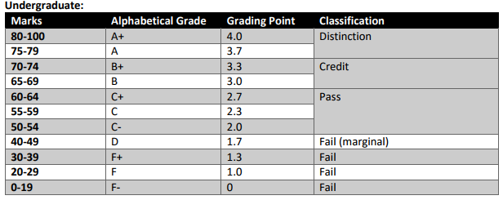
Achievement requirements

Slide 13
Question and answer session
Q & A

Slide 14
What we will cover next
Project Briefing

